Slide 1

Human activity Recognition with Wi-Fi Using Machine Learning for Building Automation and Energy Saving
Tanmay Mane
Supervisor – Prof. Dr.-Ing. H. C. Jürgen Becker
Advisor - Prof. Dr.-Ing. Adolfo Bauchspiess, M. Sc. Iris Walter

Slide 2
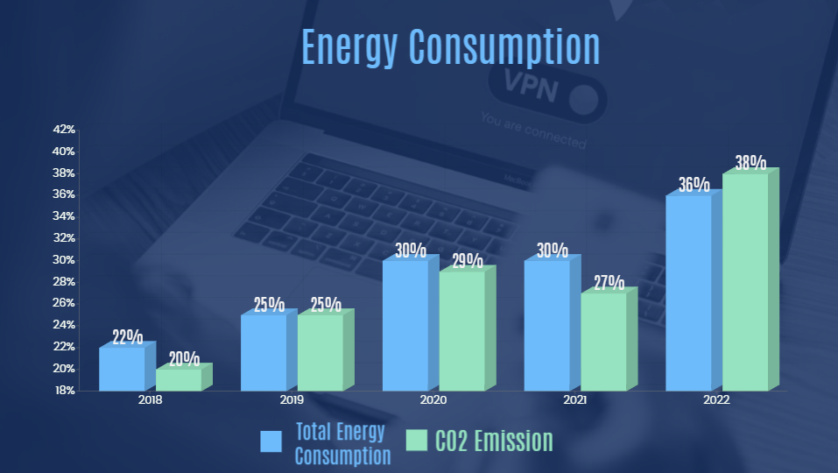




Introduction
Increasing energy consumption
Meeting the world's energy needs sustainably is a current challenge
50% - HVAC. Residential buildings share - 26%, non-residential buildings had 10%.
Next 30 years – Energy demands increases by 50% - 60%
Energy Consumption of global buildings

Slide 3







Research Objective
Smart Building Energy Management (SBEM) technology.
Reduces carbon emissions, Energy costs, and enhancing user comfort.
Solution - Device-free Human activity recognition (HAR) with Wi-Fi signals using ML.
HAR through sensors
ML and Optimization
Enenrgy saving for building automation
The overview of HAR with Wi-Fi using ML

Slide 4
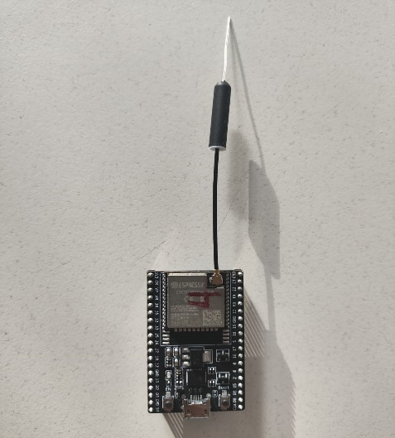
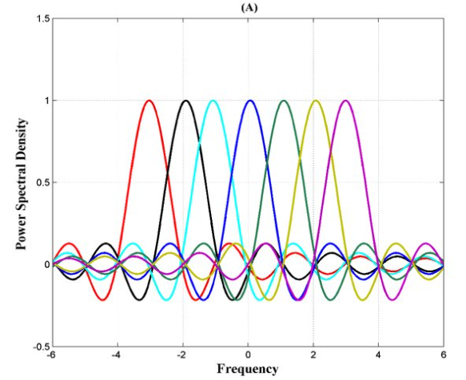



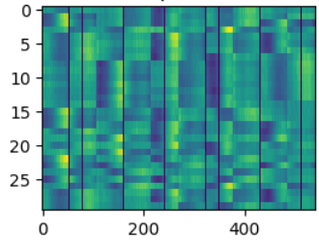


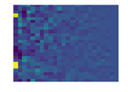


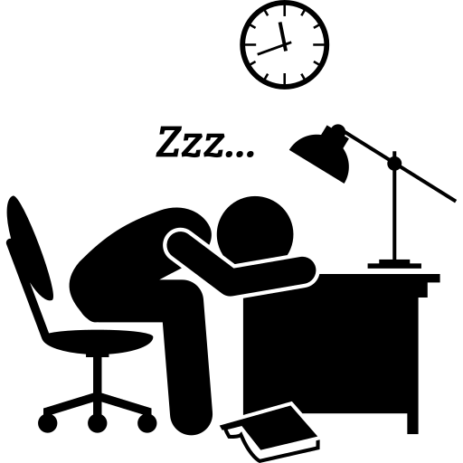


Theoretical Background
ESP32 NodeMCU -
OFDM -
Multiple orthogonal sub-carrier
802.11b/g/n
4 MB SPI flash
Low-cost Microcontroller
High data rate
Reduced ICI and ISI
CSI for each Carrier
MIMO -
Spatial multiplexing
Spatial Diversity
ESPNOW Protocol -
Channel State Information -
How signal travels from Tx to Rx
Amplitude attenuation and phase shift for ENV, Human activity
2.4 GHz wireless connection
Peer to peer connection. Pairing required
Use call-back function.
Works with MAC address header
Max working range ~ 400 meters
CSI amplitude
ESPNOW
Rx
Tx
CSI phase

Slide 5
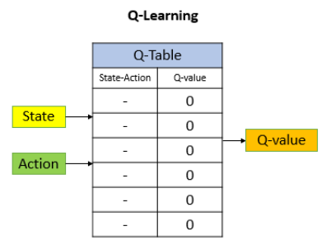
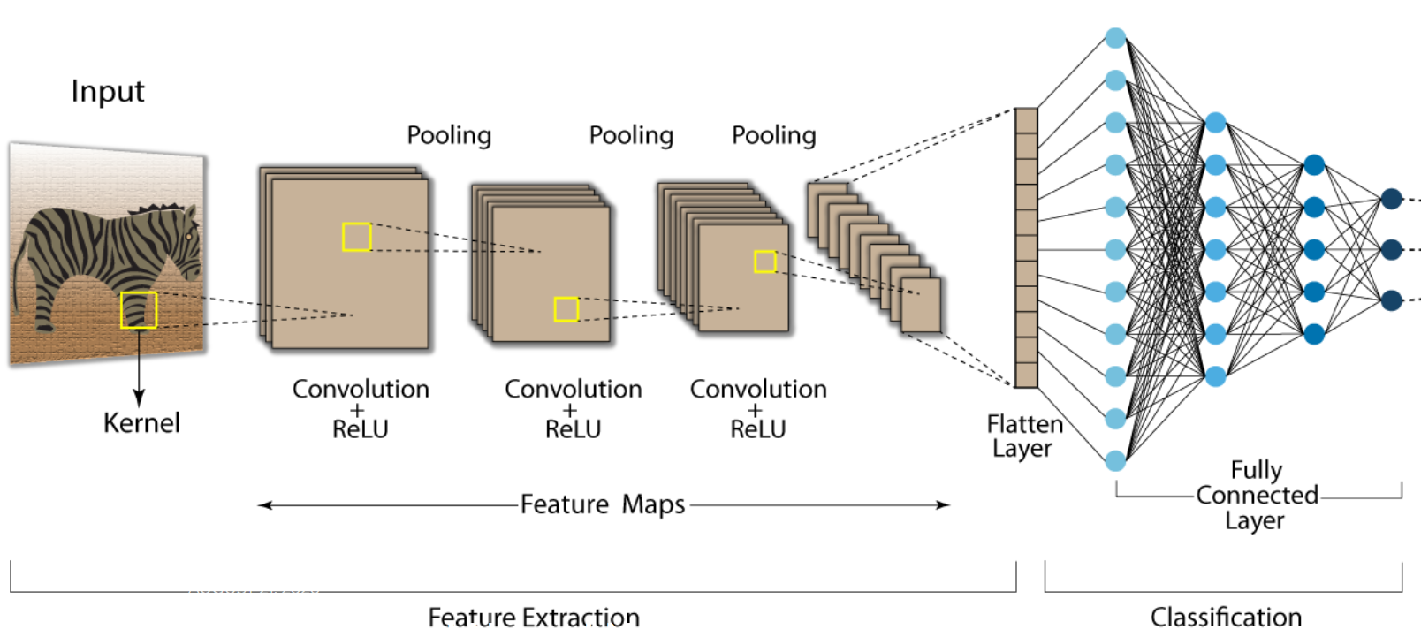
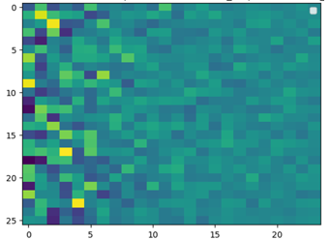
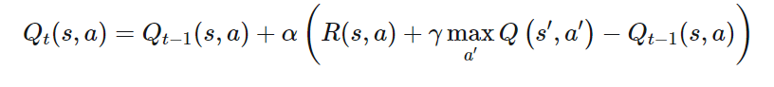
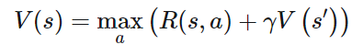
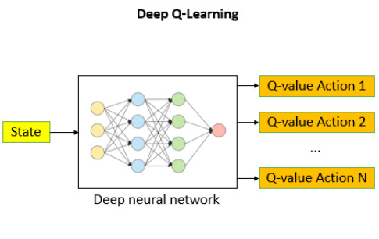
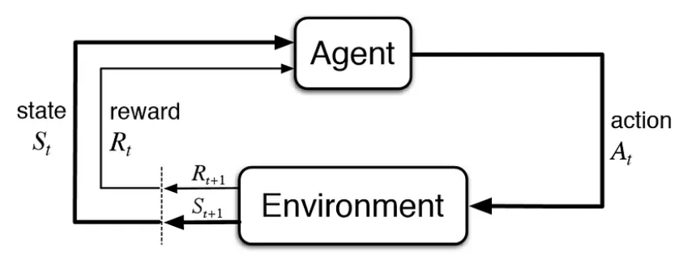
Theoretical Background
Convolution Neural Network (CNN) -
Q - Learning -
Process data that has grid pattern
output
Next possible estimated best action
Model-free approach
sit
Q-value - measure an action at a particular state
stand
walk
Bellman Equation -
Reinforcement Learning (RL)-
Deep Q –Learning Network (DQN) -
Exploration and Exploitation
learning method
Bellman Equation -
Neural Network instead of Q - table
Epsilon-Greedy exploration strategy
Agent>action>Env>reward

Slide 6
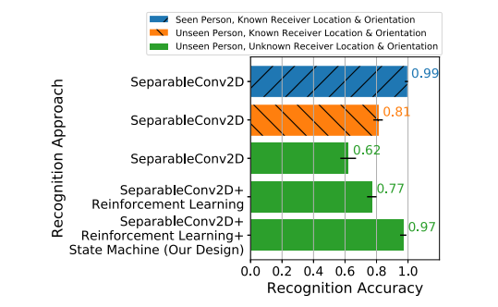
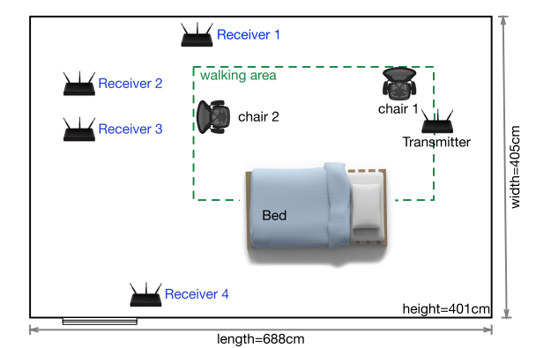
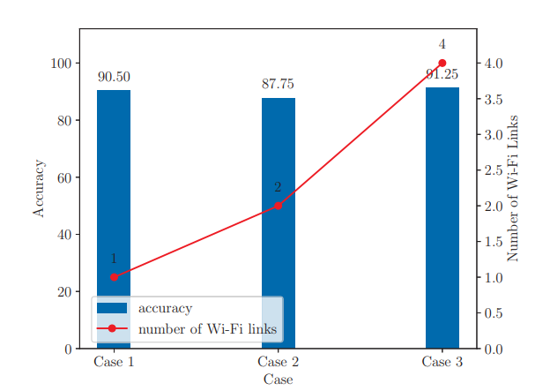
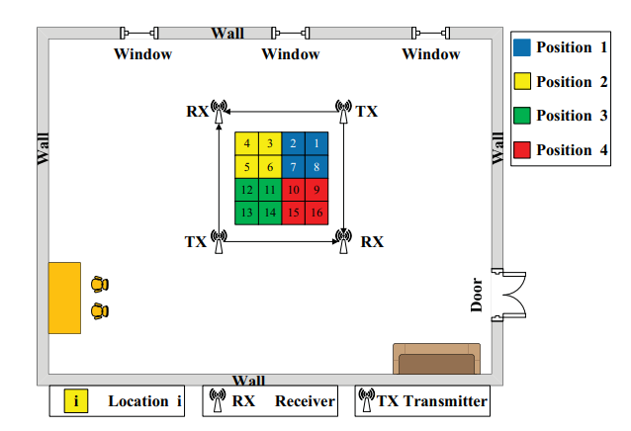
State of the Art
Location- and Person-Independent Activity Recognition with WiFi, Deep Neural Networks, and Reinforcement
Learning - Y. Ma.
2D CNN as Recognition algorithm
Reinforcement Learning - LSTM
5 activities performed by 7 persons.
97% on unseen Person, 2D CNN – 99%
WiAgent: Link Selection for CSI-Based Activity Recognition in Densely Deployed Wi-Fi Environments - 2021 IEEE
Case 1: Use a Wi-Fi link selected by WiAgent.
Case 2: Use two orthogonal Wi-Fi links.
Case 3: Use all Wi-Fi links.
Architecture - CNN, LSTM

Slide 7

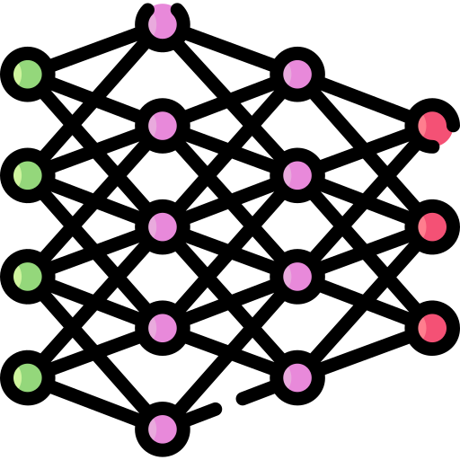

The Framework of HAR
Data Acquisition
Data Preprocessing
Feature Representation
Reinforcement Learning
Application
ESP32 NodeMCU
Cleaning CSI Data
-delete & Insert
CNN Block
Create ENV
Activity Recognition
Data augmentation
Reward, action
CSI amplitude
ESPNOW protocol
Convolution
HAR with WIFI
Max pooling
Fully connected Network
DQN network
Transfer Learning
CSI denoising
Phase sanitization
Image classification
PCA analysis
Model training
Accuracy/Loss on transfer Learning
CSI Information
Image classification
Antenna Setup
Data labeling
Tx – 2
Rx - 5
Segmentation
Accuracy/Loss on Transfer Learning

Slide 8
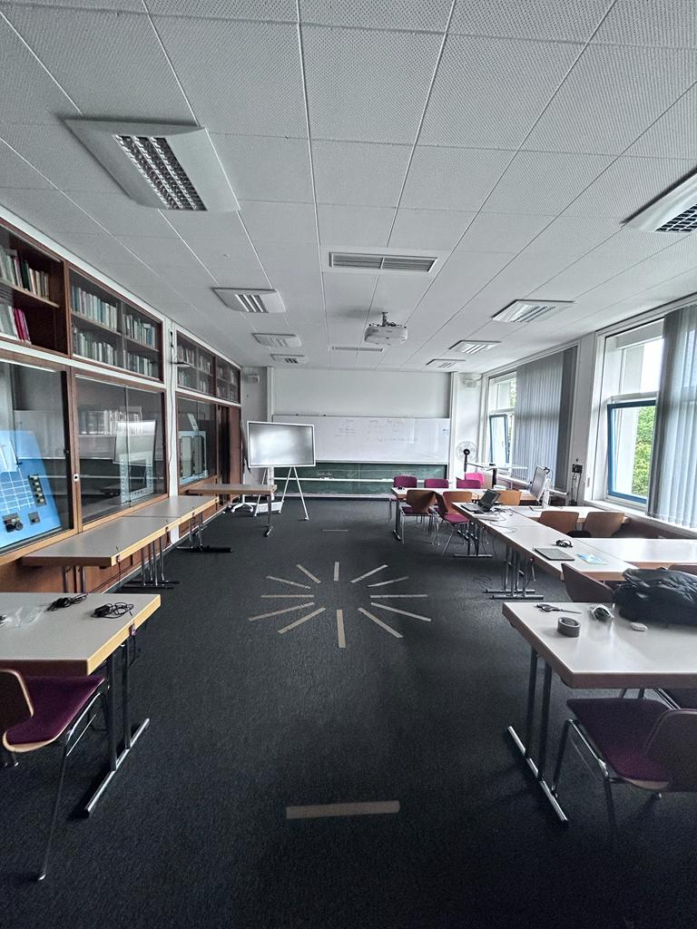
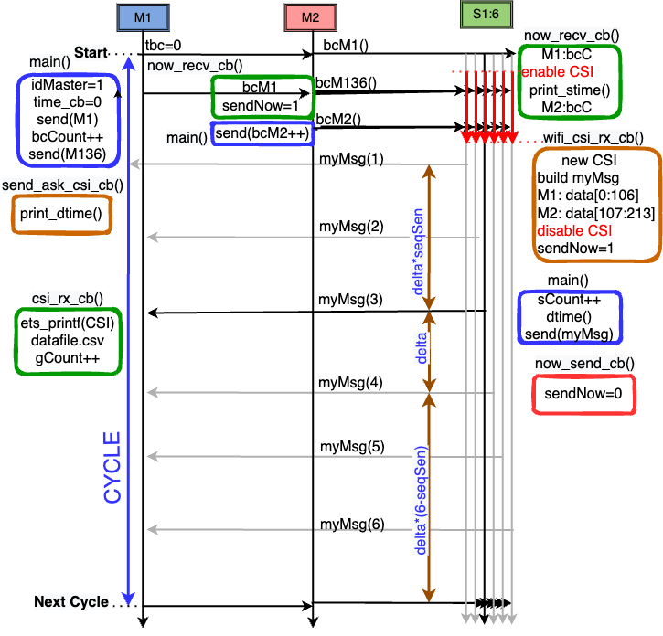
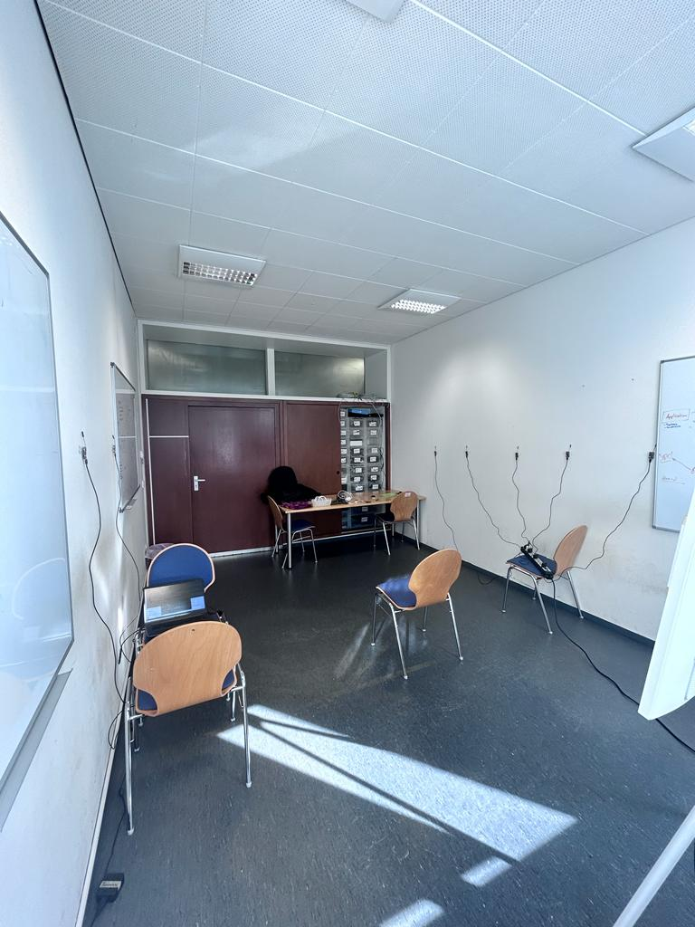
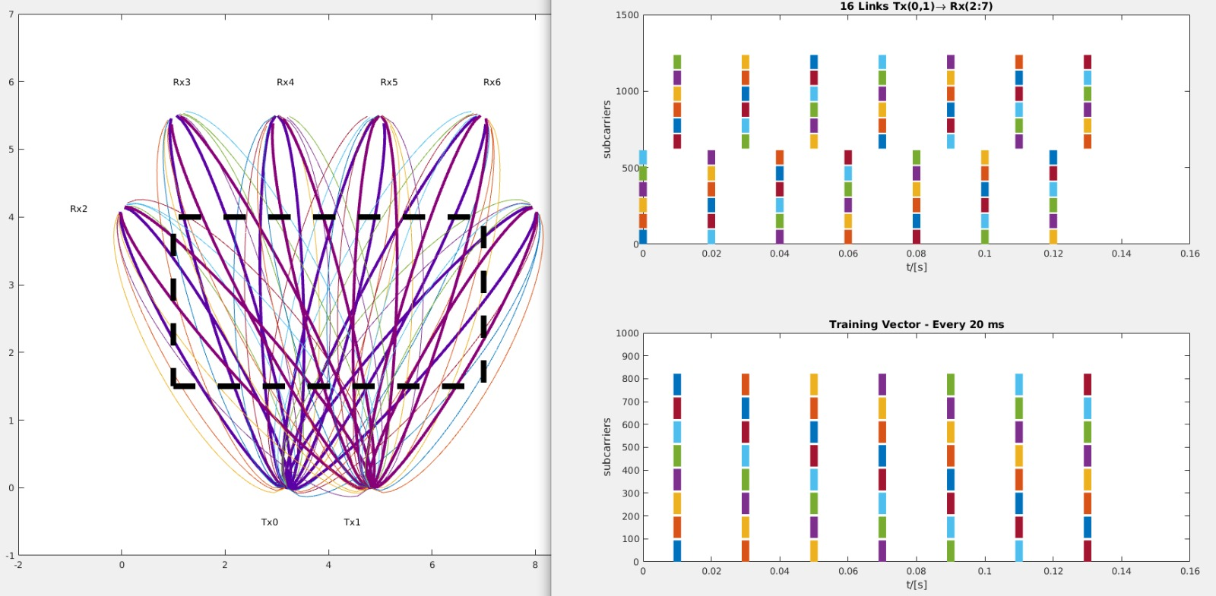
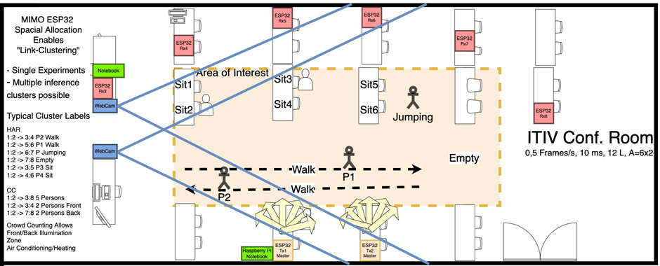
Data Acquisition
Sensor configuration setup
Tx – 2 ESP32
Rx – 6 ESP32
Features are similar
Framework of CSI transmission
Training ENV_1
M1 starts the process with broadcast.
CSI enable.
M2 sends the broadcast.
M1 collects CSI from all sensors.
Use TDMA
Same acquisition time.
S7
S8
S6
M2
M1
S5
S4
Test ENV_2
S3
M1
S4
S6
S7
S3
S5
M2
10 links, 1 Antenna
M1:M2 S3:S8
54 subcarrier.
10*54 = 540 useful samples.
Define Cycle = 75 // 750 ms

Slide 9
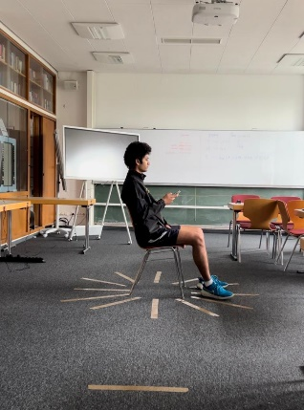
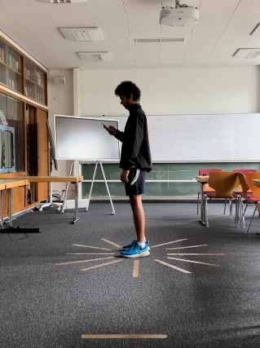
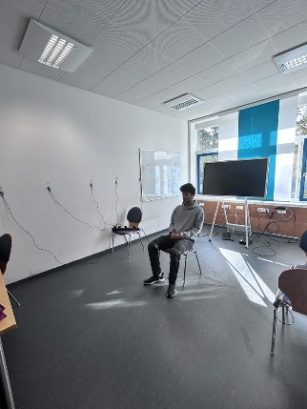
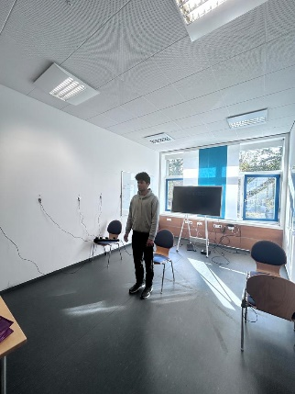
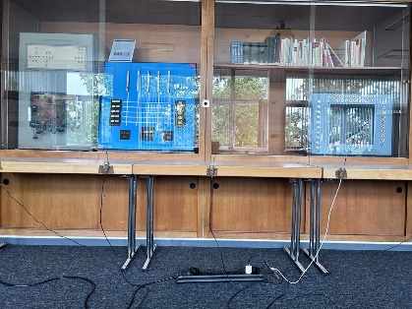
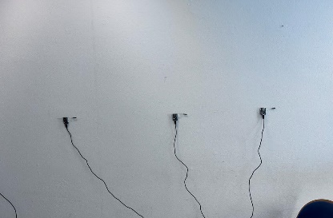
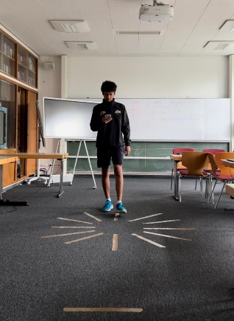

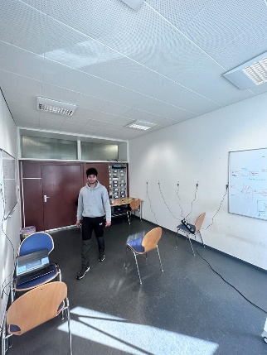

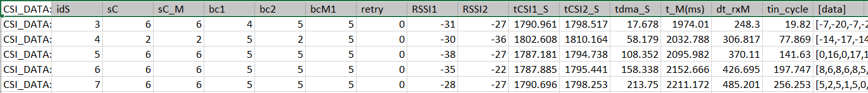
Data Acquisition
Antenna Direction Vertical
Sit
Stand
Sit
Stand
Configuration Setup
Tx – 2 ESP32
Rx – 5 ESP32
4 Activities – 4 classes
Sit – 30 sec
Stand – 30 sec
Walk – 30 sec
Empty – 30 sec
Total 2 min Activity HAR
Walk
Empty
Walk
Empty
Data collection of 4 different person for Training ENV_1 and Test ENV_2.
Antenna Direction Horizontal
Person 1 in Training ENV_1
Person 1 in Test ENV_2
1 cycle of CSI data

Slide 10
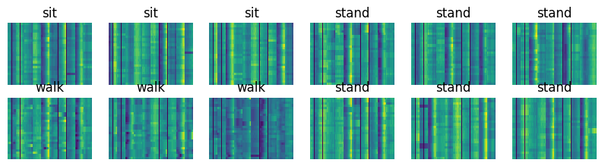
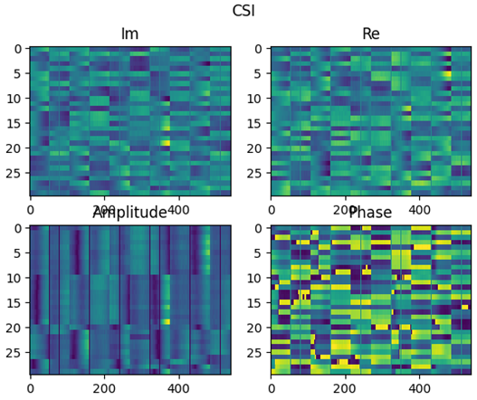
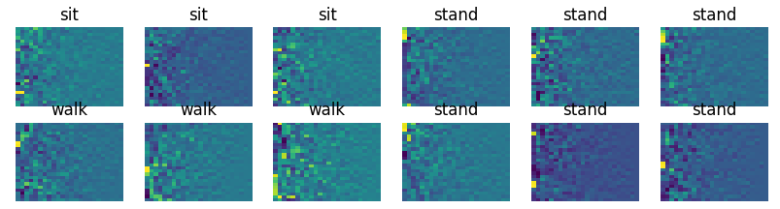
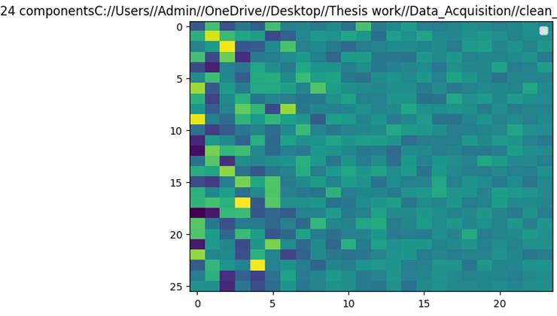
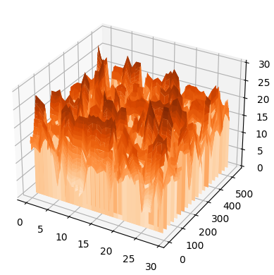
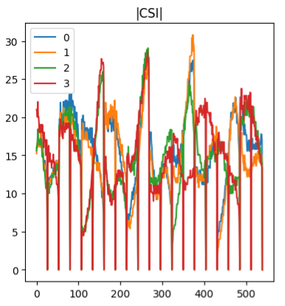
Data Preprocessing
CSI Image with activities
Clean CSI data -
Insert and delete misbehaving lines in CSI data acquisition
Remove unwanted Noise
Phase sanitization of the data.
CSI image with amplitude and phase -
Cycle per 10 sec
25 cycles/10 sec
75 cycles/30 sec
Subcarrier length
PCA
PCA component – 24
25 cycles per 10 sec
Im and Re part gets separated and mapped Am and Pha

Slide 11
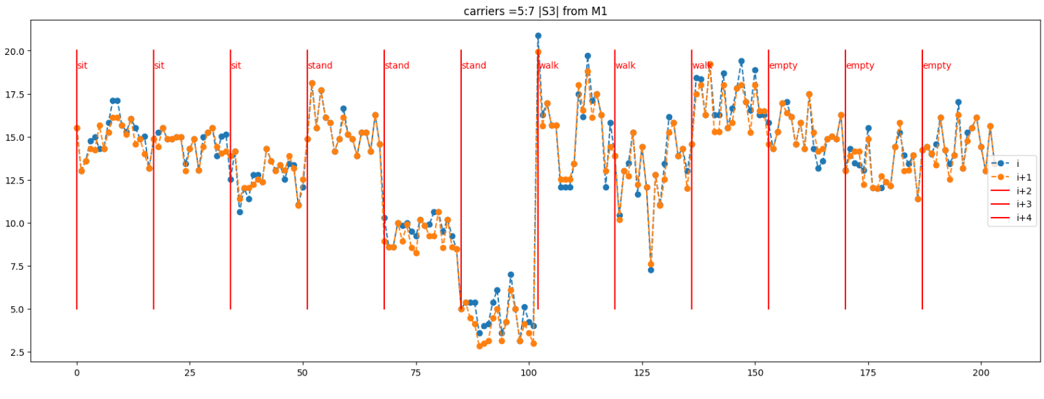
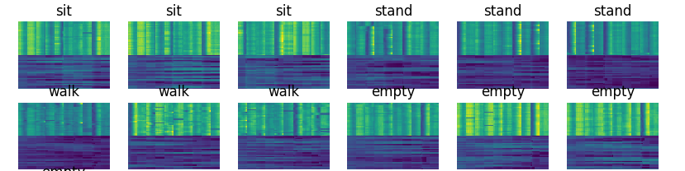
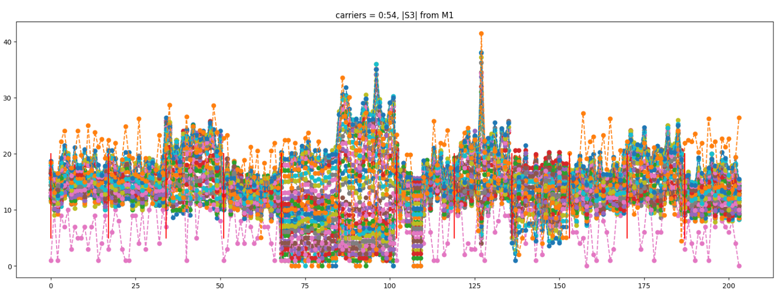
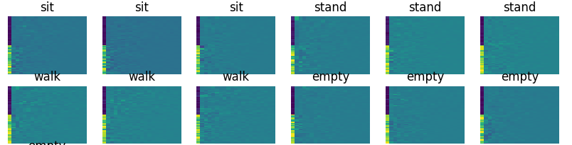
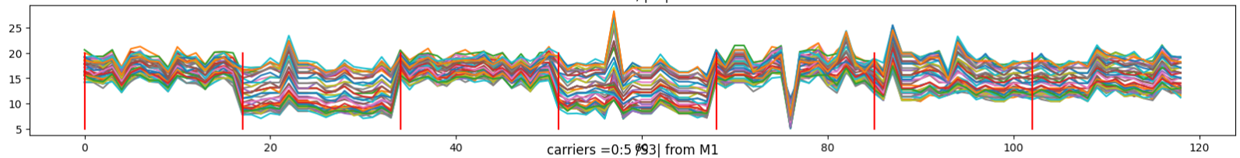
Data Preprocessing
Consecutive CSI from sensor 3 with varying subcarrier
CSI image with Am and Pha combine
Apply
PCA transformation
Sit
Sit
Sit
Stand
Stand
Stand
Walk
12 image frames per 2 min experiment
For training – 4 person 2 min activity – sit, stand, walk, empty
12 * 4 = 48 Images for Vertical Antenna direction
12 * 4 = 48 Images for Horizontal Antenna direction
CSI PCA images >> feed to Neural network
All 54 carriers combine with activity for S3 sensor

Slide 12
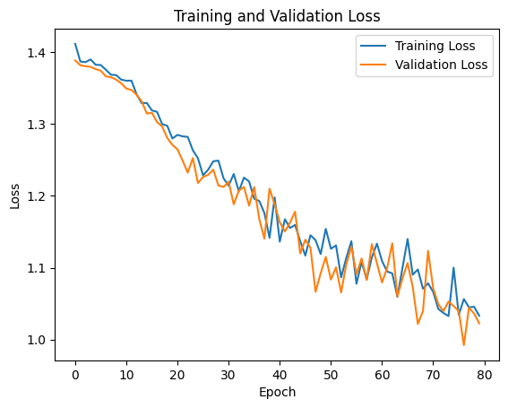
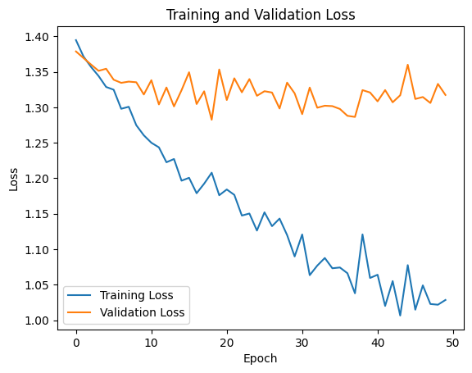
Feature Representation
Adaptation and Improvements
Convolutional NN approach
self.label_map = {"empty": 0, "sit": 1, "stand": 2, "walk": 3}
Use data augmentation approach -
CSI HAR – Tx – 2 and Rx – 5
Sit, Stand, Walk, Empty
96 data Images
Random crop size
Horizontal flip
Vertical flip
Rotation range
batch_size = 4
criterion = nn.CrossEntropyLoss()
optimizer = optim.Adam(model.parameters(), lr=0.0001)
num_epochs = 50
Use 2D Conv layer
Increase no. of epoch
Add drop layer – 0.3
Resizing of image (24*24)
65 train images
31 test images
Best acc: 83.333%
Best acc: 42.553%

Slide 13
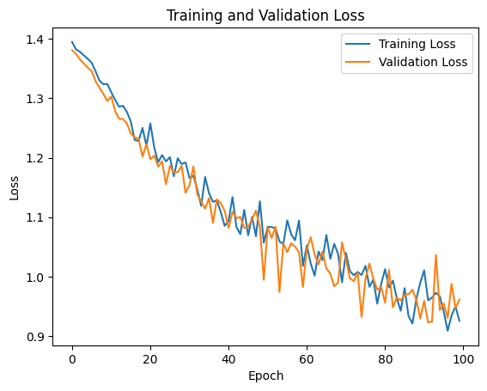
Feature Representation
Increase depth
Use two dense layer
Softmax classifier
Best acc: 93.055%
Layer | Name | Size | Parameters | Activation
1 | Conv 2D | Kernel 3 x 3(16) | Stride = 2 | ReLU
2 | Max pooling | Kernel 2 x 2 | Stride = 2 | none
3 | Conv 2D | Kernel 3 x 3(32) | Stride = 2 | ReLU
4 | Dropout | none | Rate = 0.3 | none
5 | Max pooling | Kernel 2 x 2 | Stride = 2 | none
6 | FC | 4 | none | Softmax
7 | FC | 4 | none | Softmax

Slide 14
Reinforcement Learning
Reinforcement learning using Q-learning
Adaptation and Improvements
CSI HAR – Tx – 2 and Rx – 5
Sit, Stand, Walk, Empty
96 data Images
Combine approach -
2D CNN model with Q – network
Replace Q – table with NN
Build DQN model
Q-learning parameters -
Build the custom Environment using OpenAI gym
classActivityRecognitionEnv(gym.Env):
env = ImageClassificationEnvironment(n_classes=4) agent = QLearningAgent(n_classes=4)
Batch size – 32
Discount factor – 0.9
Learning rate – 0.001
Target update Freq – 20
No of episodes - 1000
Reward –
Every correct action = 0.3
Every wrong action = -0.3
Parameters | Initial Values | Adaptations
Batch Size | 32 | 30
Discount Factor | 0.9 | 0.8
Learning Rate | 0.001 | 0.00025
Target update Freq. | 20 | 10
Reward for correct action | +0.3 | +0.1
Reward for Negative action | -0.3 | -0.1
Optimizer |  | Adam
Best acc: 13.553%

Slide 15
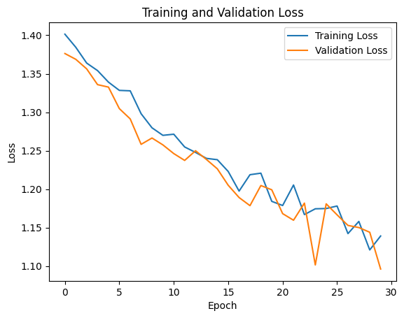
Reinforcement Learning
Validation of RL using DQN
Initialization
Training -
Best Test accuracy – 75%
Validation Loss – 1.09
Train Loss – 1.13
Data preprocessing
Training Loop
Episode Init.
Action selection
Env Interaction
Store experience
Sample batch
Q-value update
Exploration
Check for Termination
Convergence Check
Model Deployment for Decision

Slide 16


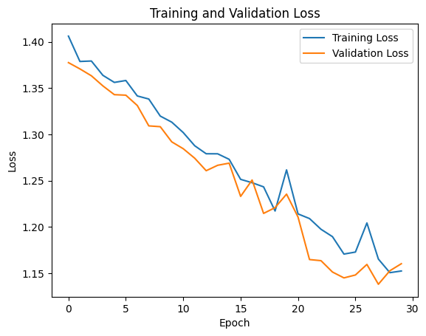
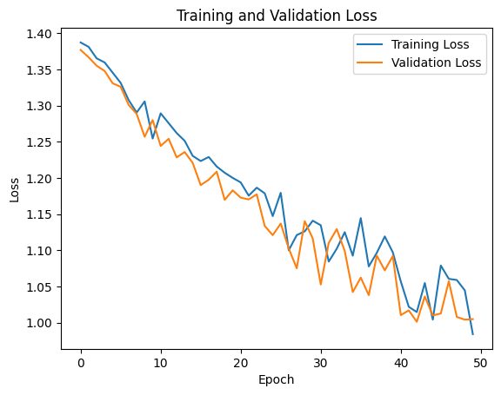

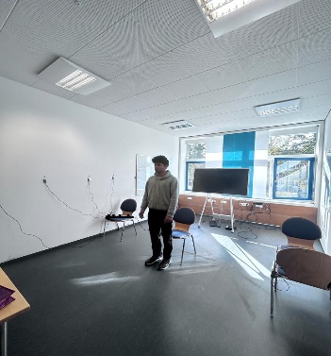


Transfer Learning Results
Cross Environment Validation using only CNN
Cross Environment Validation using DQN
Unknown location known person –
Training ENV_1
Test ENV_2
Unknown location known person –
Best Test accuracy – 88%
Validation Loss – 1.00
Train Loss – 0.98
Best Test accuracy – 73%
Validation Loss – 1.16
Train Loss – 1.15
Person 1
Person 1
Unknown location unknown person –
Best Test accuracy – 69%
Validation Loss – 1.17
Train Loss – 1.18
Unknown location unknown person –
Best Test accuracy – 79%
Validation Loss – 1.09
Train Loss – 1.05

Slide 17


Results
Results and Observed points -
4 different activity, 4 person, Antenna direction
Horizontal antenna setup made a very negligible difference.
Performance of the CNN is better.

Slide 18

Conclusion and Future Scope
Transfer Learning possible
Device free Wi-Fi sensing.
HAR without using camera and RFID is big advantage
IoT integrated building automation – Thermal comfort, energy saving.
RL algorithm required large amount of data
Future Scope -
Incorporating additional sensors for better data.
Energy saving in HVAC, securities, vehicles.
Real time HAR for building automation.

Slide 19
Thank to…..
Prof. Dr.-Ing. Dr. H. C. Jürgen Becker
Prof. Dr.-Ing. Adolfo Bauchspiess
M. Sc. Iris Walter

